Slide 1
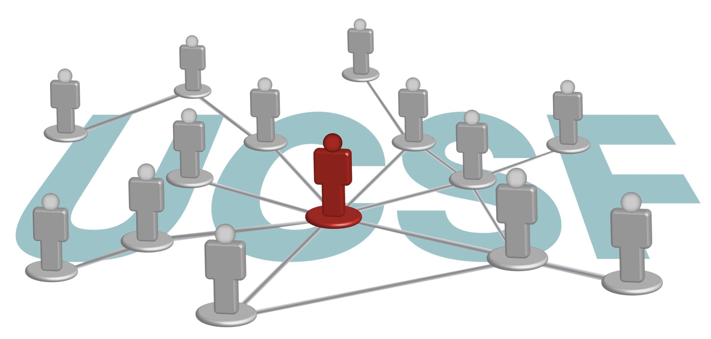
Find Experts and Collaborators with UCSF Profiles

Slide 2
What can UCSF Profiles do for you?
Search & Discover

Slide 3
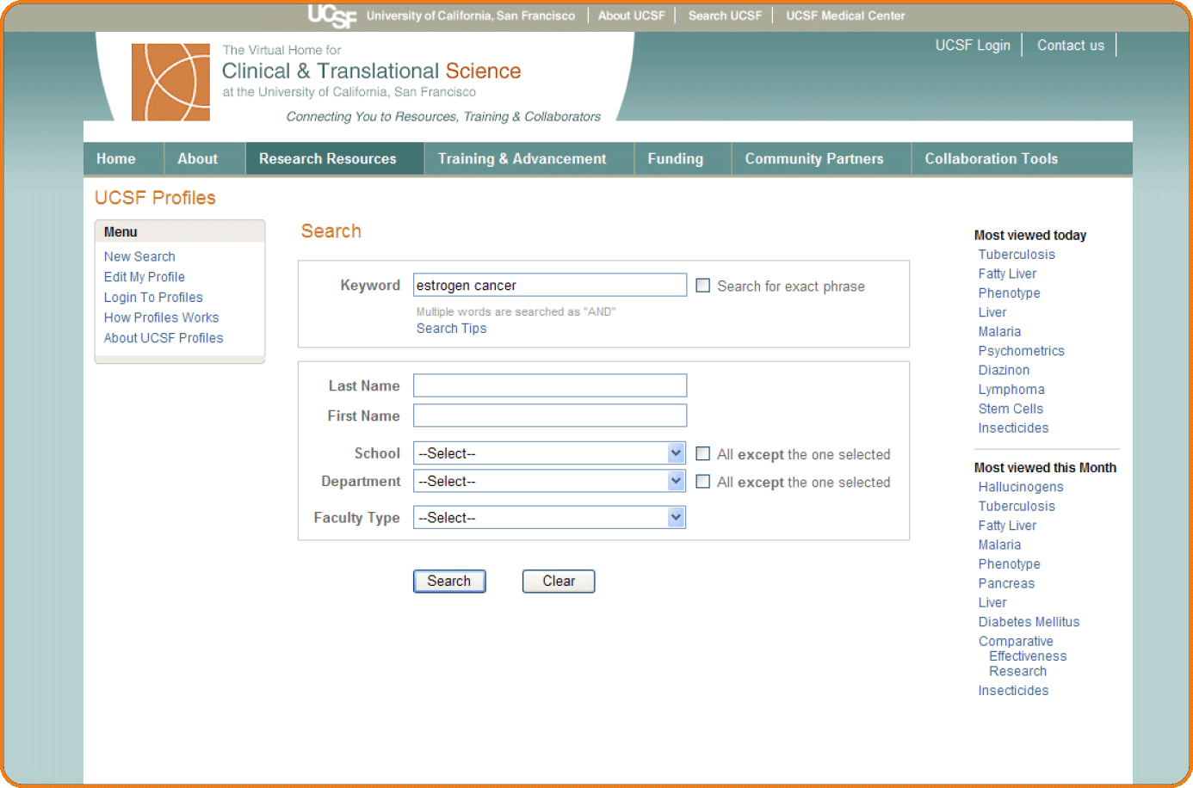

Slide 4
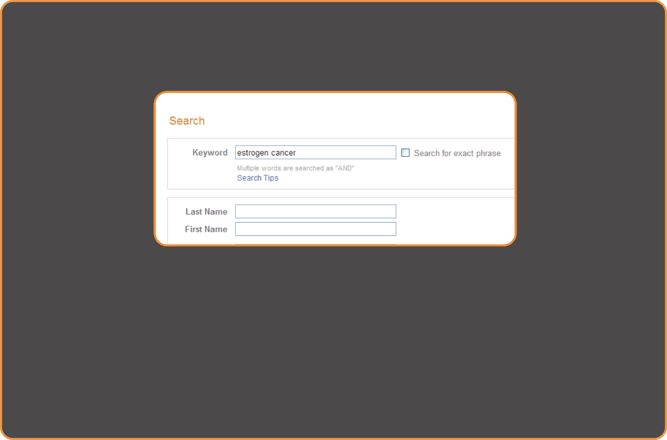
Find researchers with expertise in a particular area

Slide 5
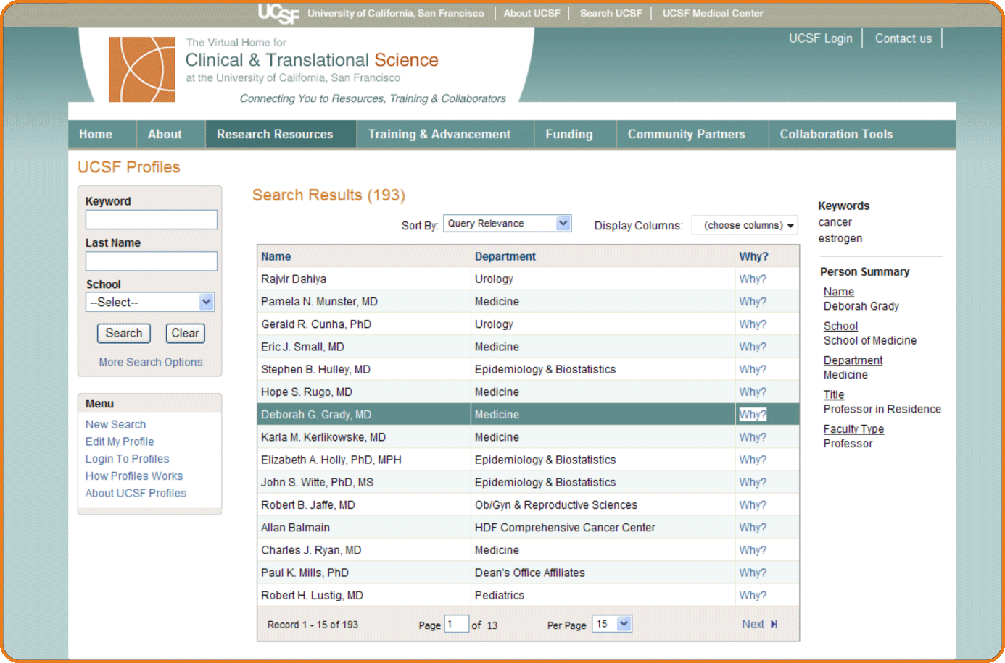
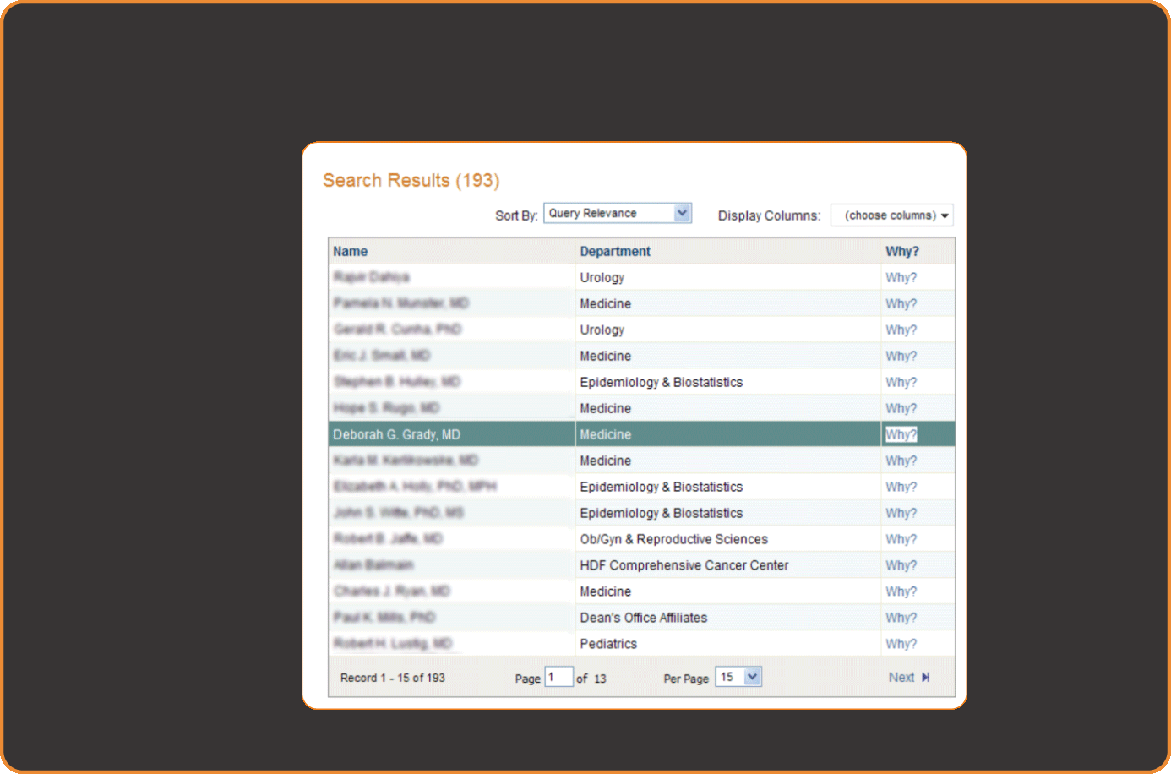
Identify researchers that have experience
in the area of your interest

Slide 6
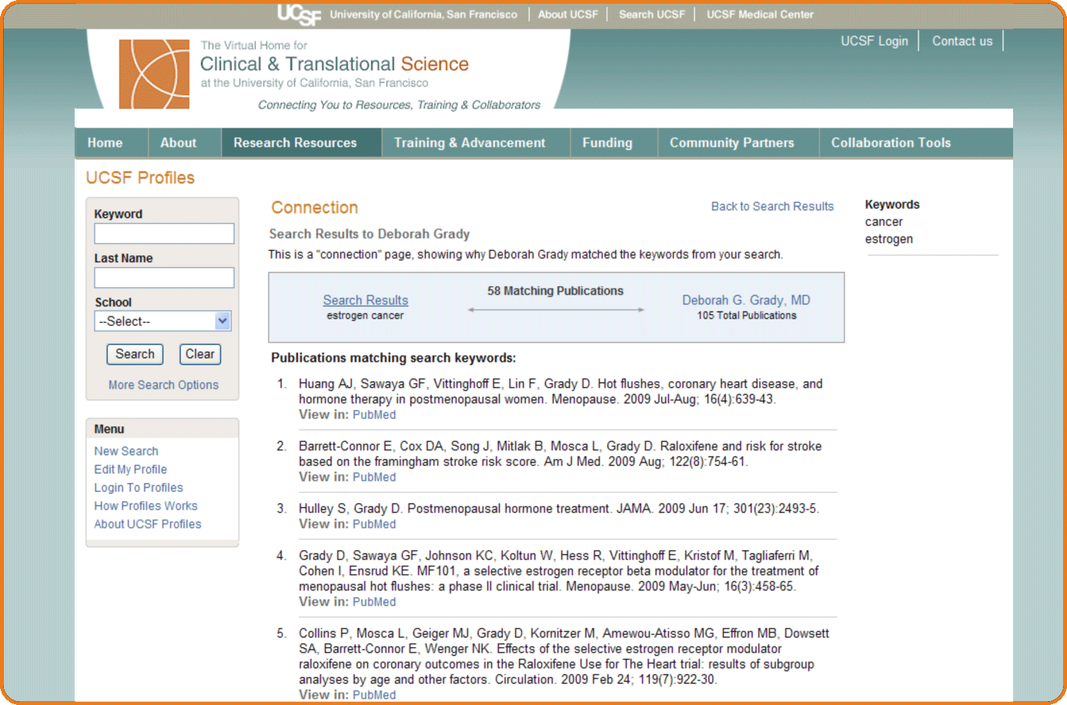

Slide 7
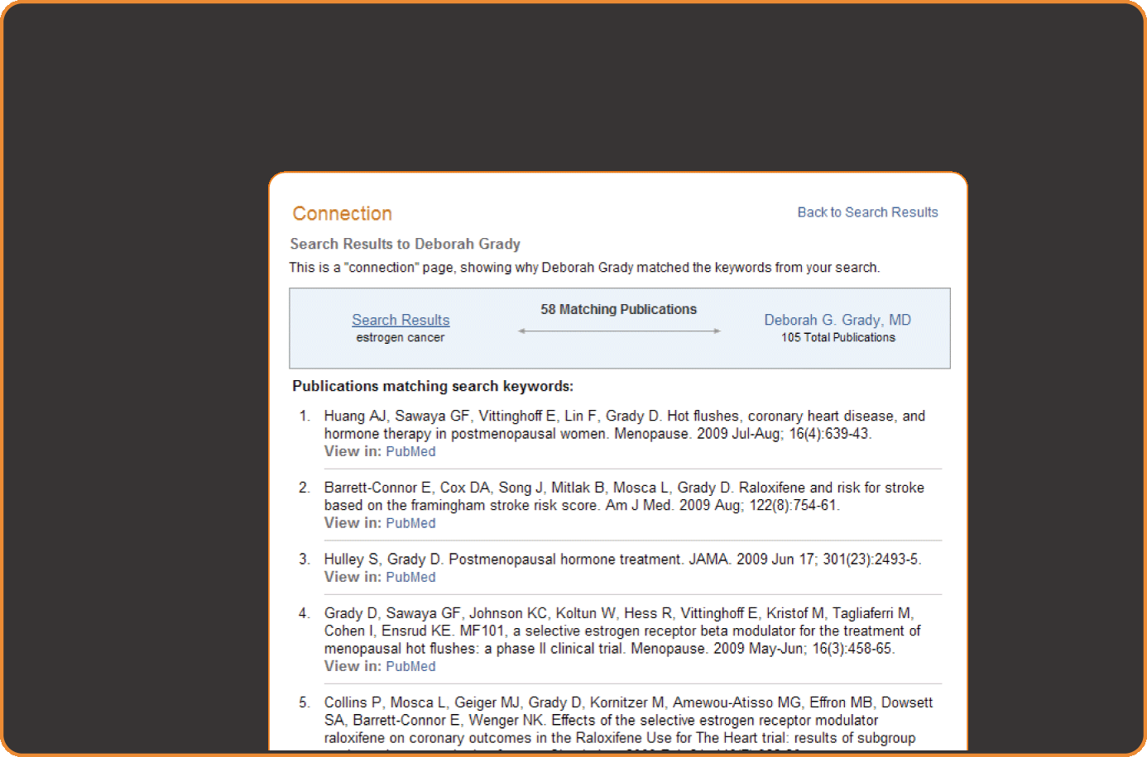
View publications that are relevant to your search

Slide 8
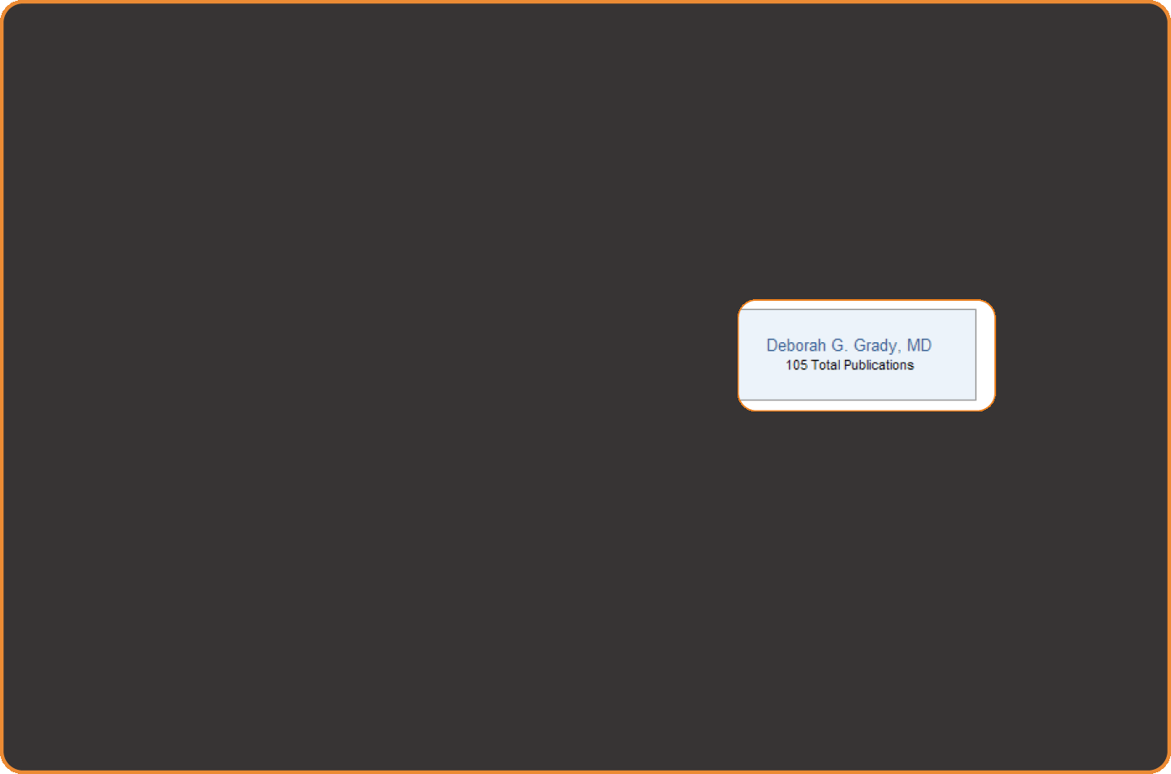
View the profile of this researcher

Slide 9
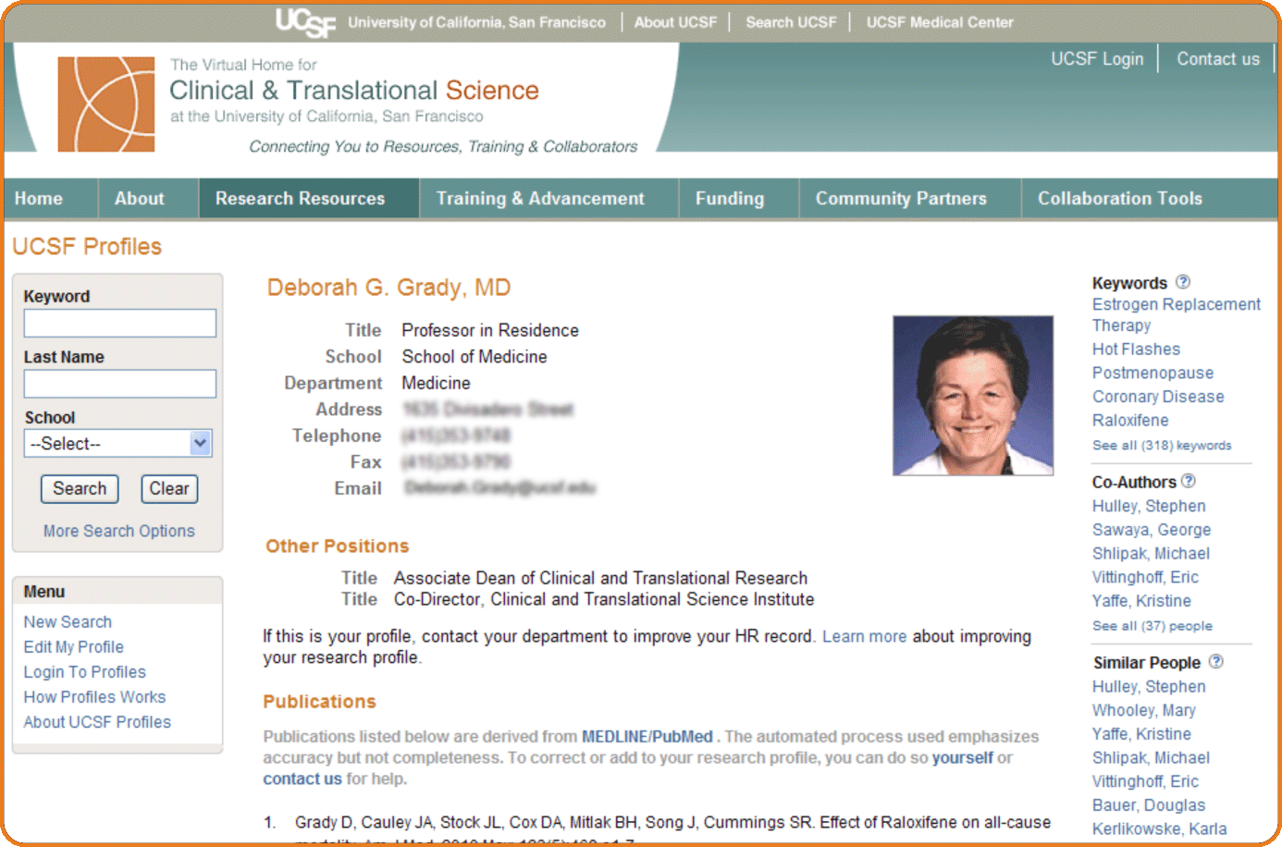

Slide 10

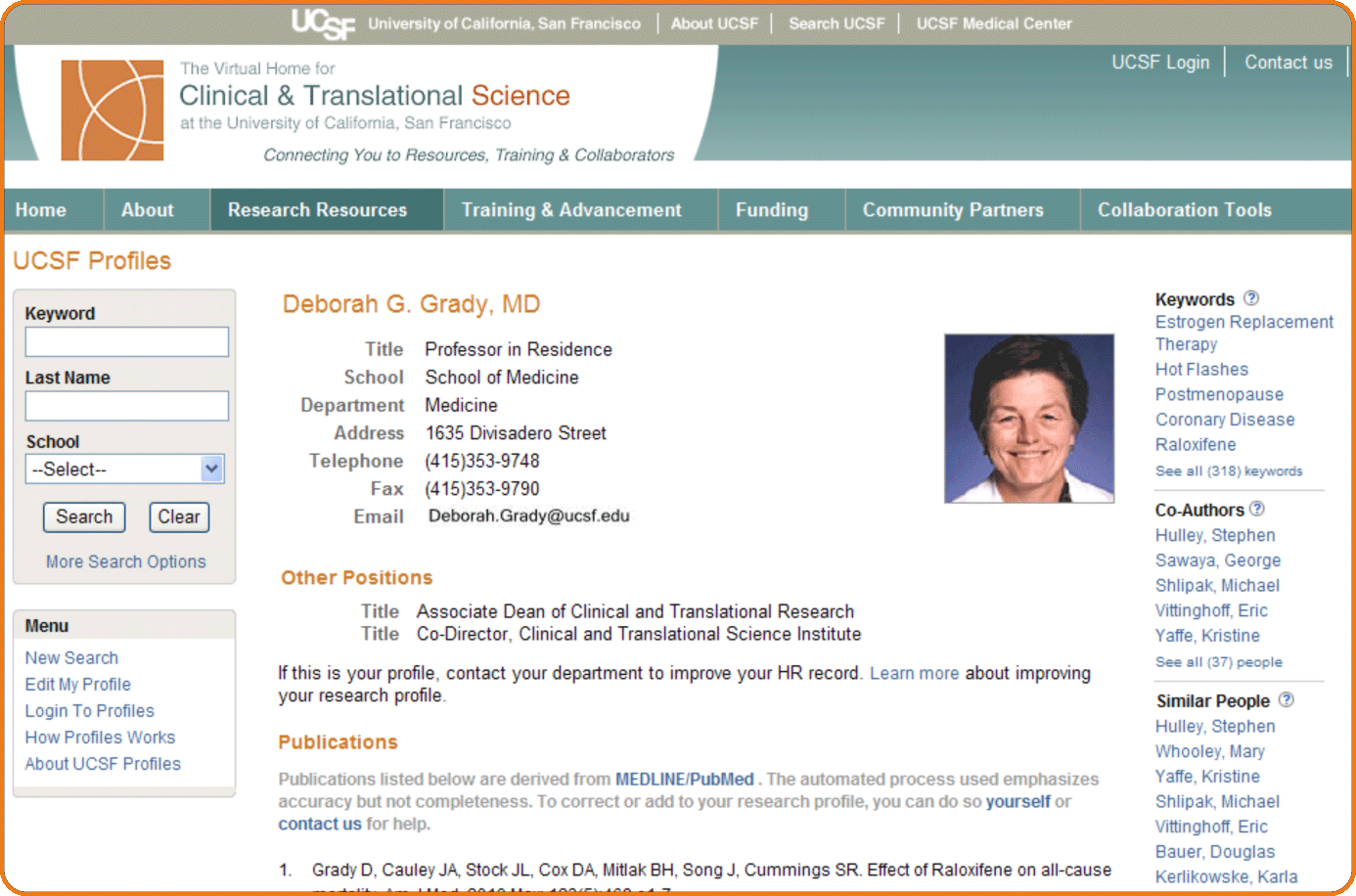
Explore the networks of this researcher

Slide 11

View keywords that describe this researchers’ work

Slide 12
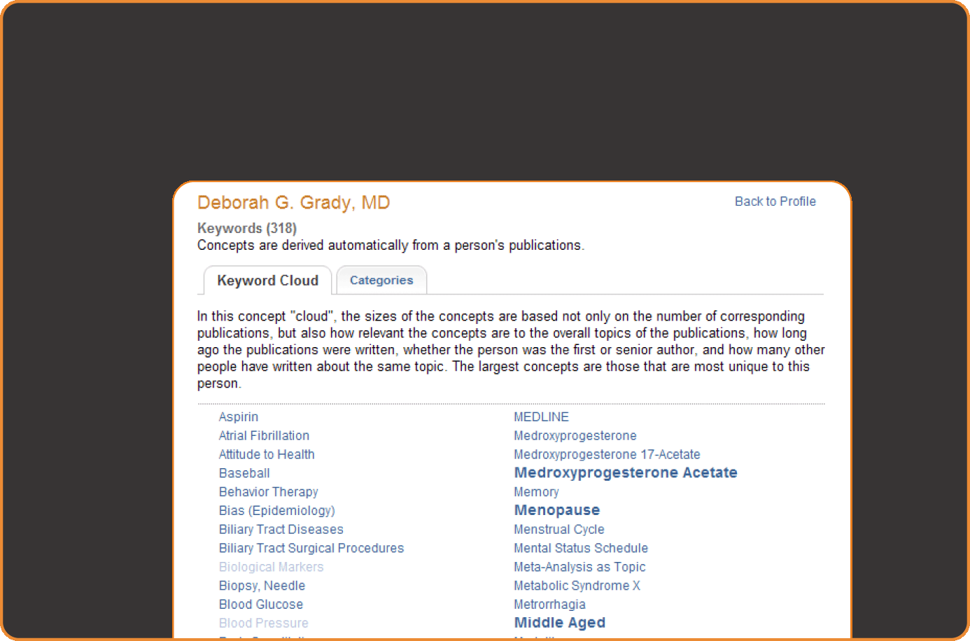
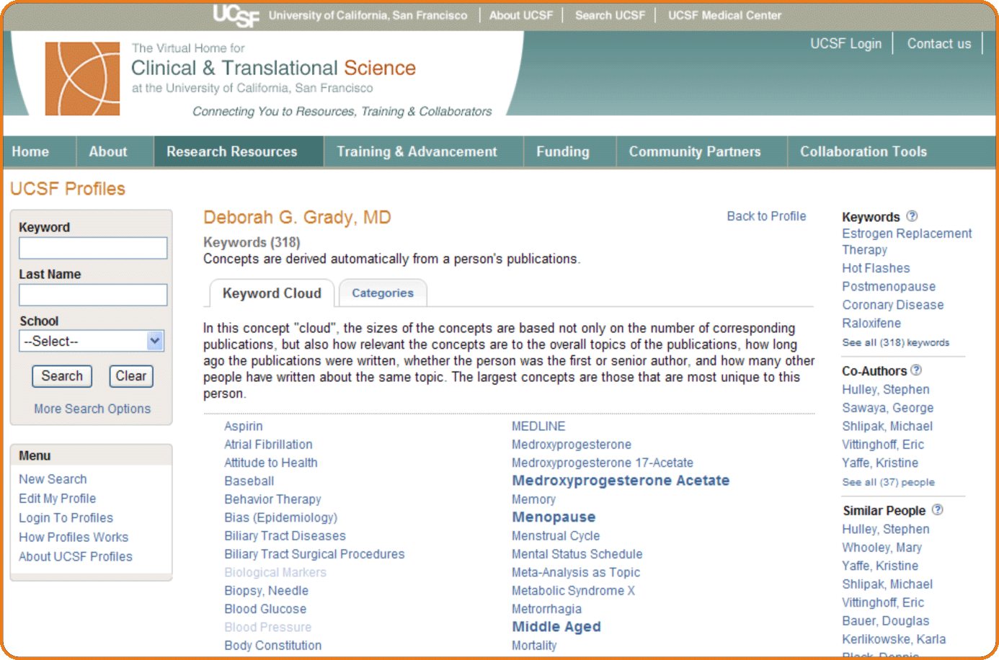
The size of keywords Reveals the topics which are most representative of this researchers work

Slide 13

Browse the co-authors of this researcher

Slide 14

Or, Find people at UCSF who have published on the same topics

Slide 15
Ready to network?

Slide 16
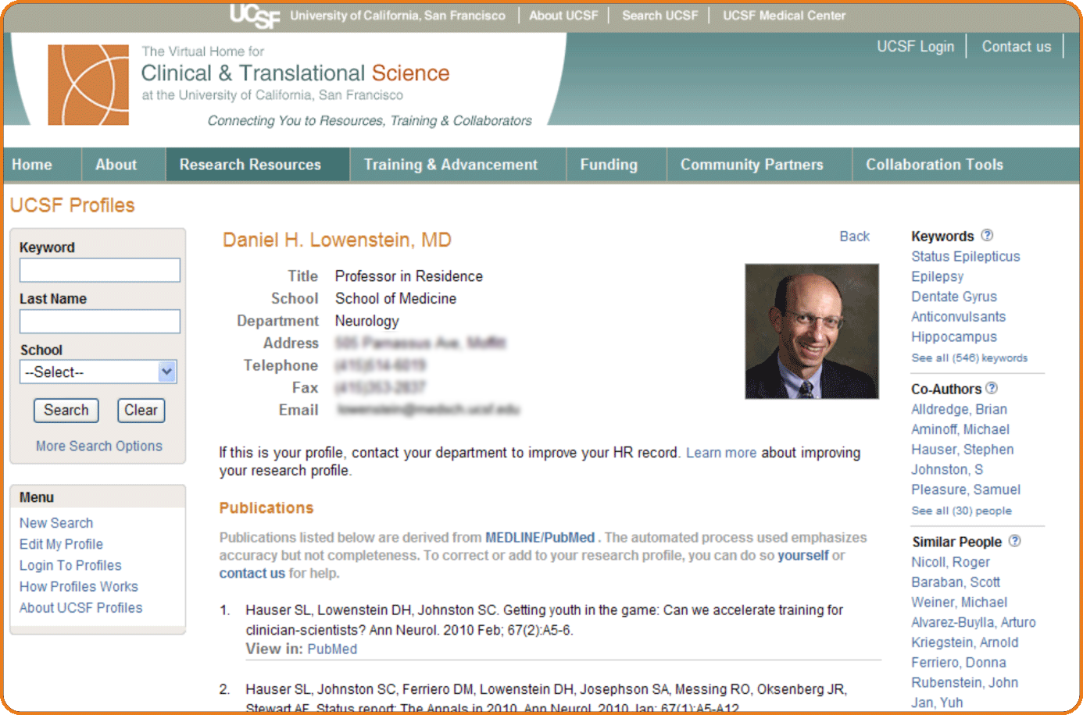

Slide 17


You can Customize your own profile

Slide 18
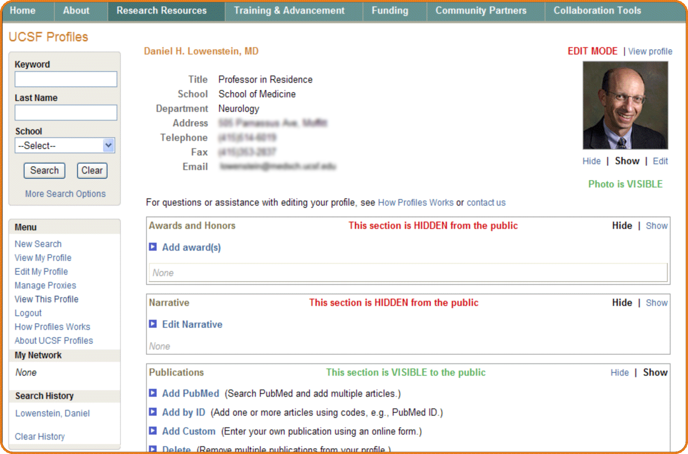

Slide 19

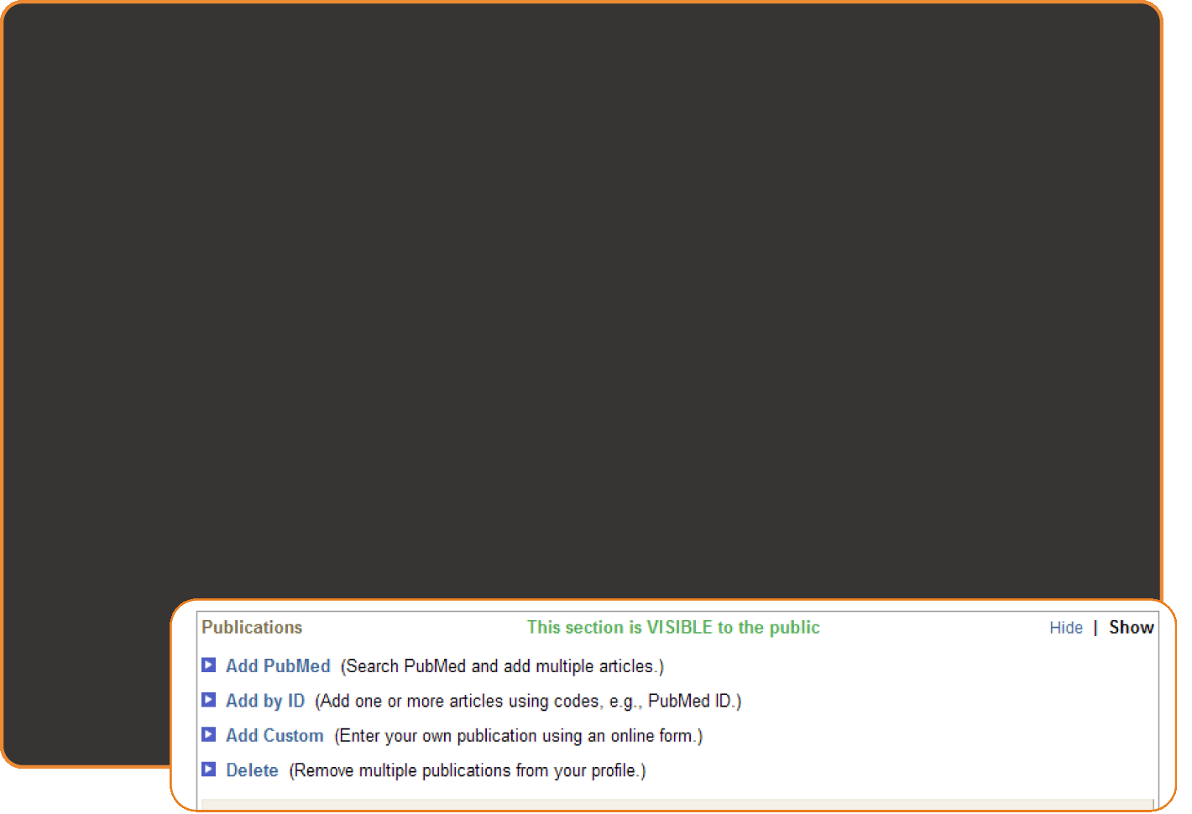
For example, you can Edit your publications

Slide 20
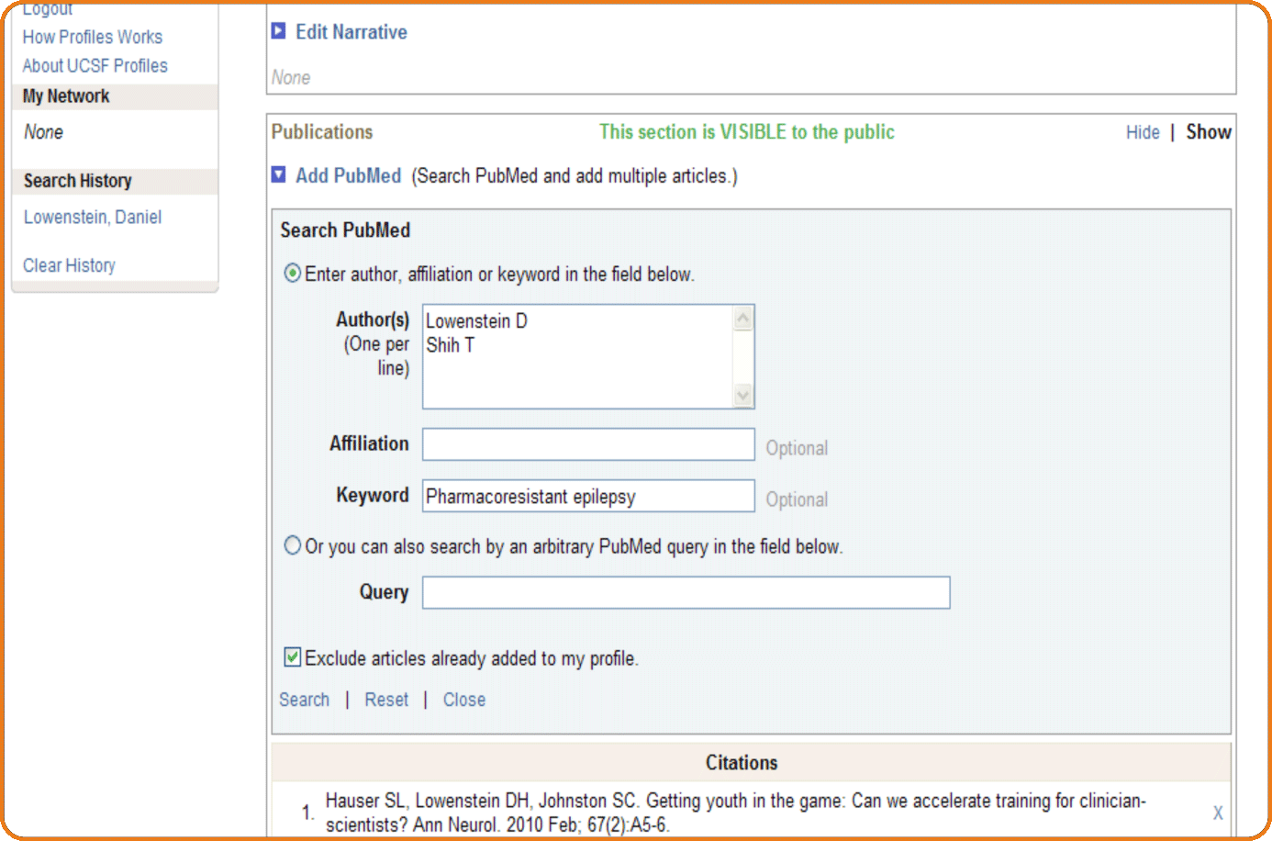
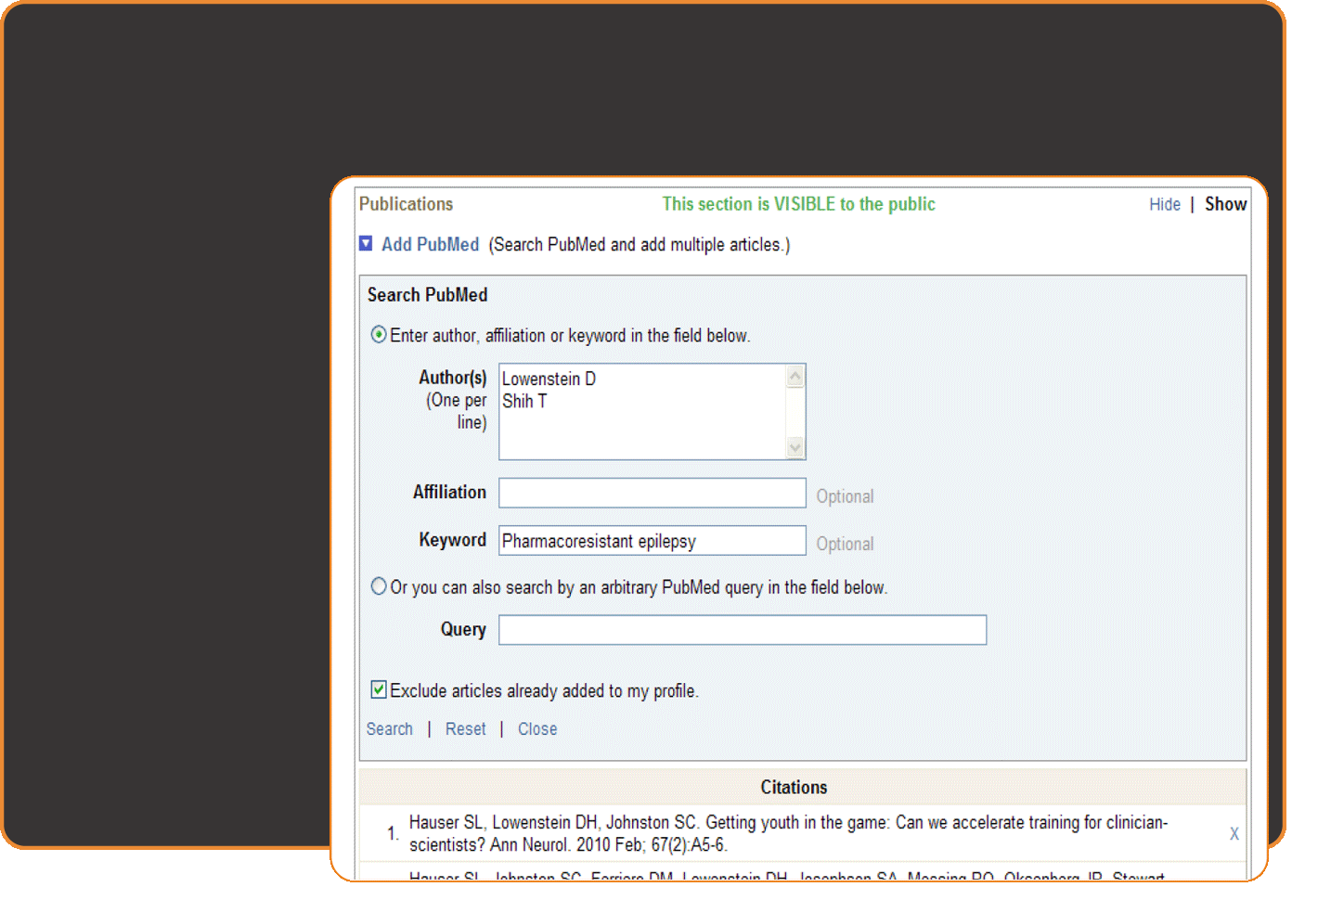
Add publications

Slide 21
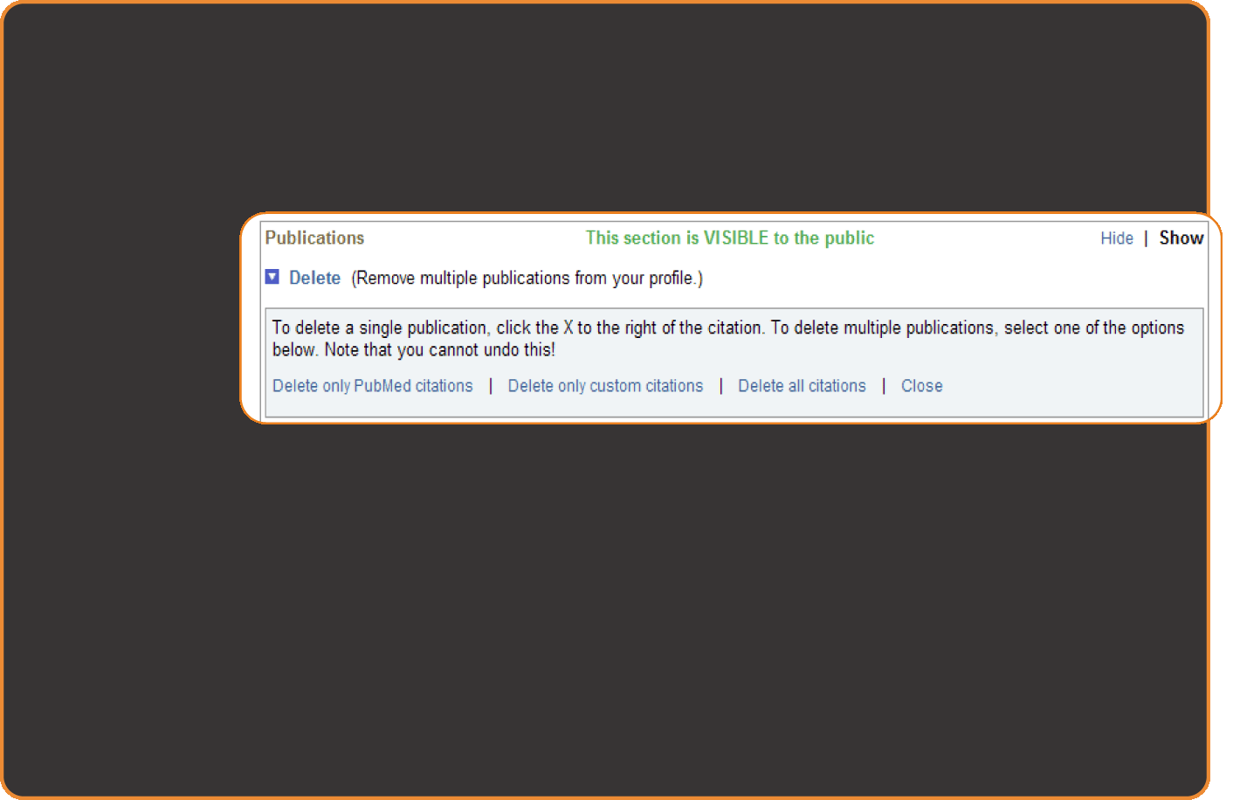
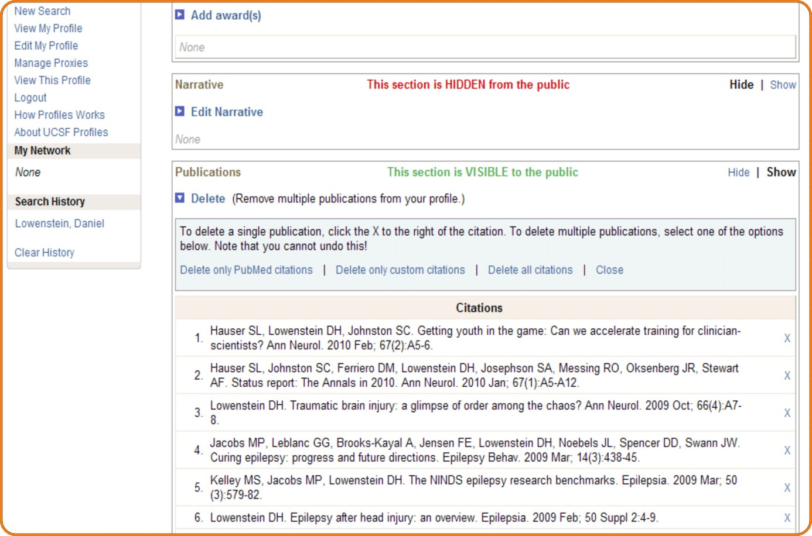
Or, Delete publications

Slide 22
And Much more…

Slide 23
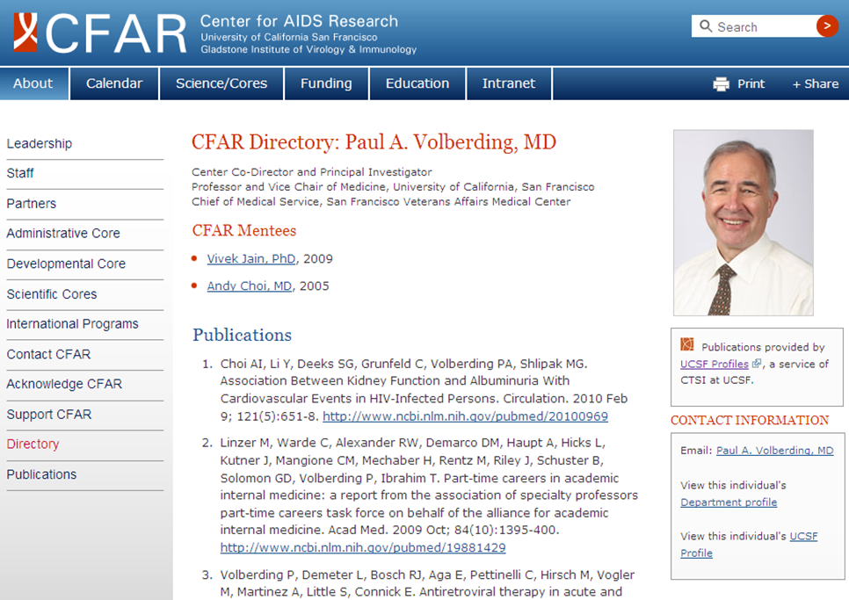
You can use UCSF Profiles for your own website
Directly integrate data feeds, such as publications, into your website.

Slide 24

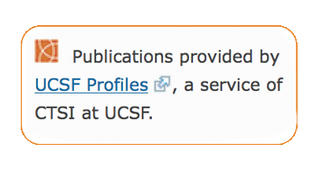
You can use UCSF Profiles for your own website
Directly integrate data feeds, such as publications, into your website.
Use UCSF Profiles data

Slide 25
UCSF Profiles will continue to grow
Mentor-mentee matchmaking coming soon.
Ideas? Suggestions? Let us know at ctsi@ucsf.edu

Slide 26
UCSF Profiles
http://profiles.ucsf.edu
search, discover, network
Thanks!
Harvard Catalyst, the creators of the open source Profiles Research Networking Software tool.

